Slide 1
Civil Projects - Surat
Surat
04-03-2022

Slide 2
Vastadevdi (B) Station – Target date of completion - July-2022
Present Status:
RCC work above Plinth Level:
First Floor slab (+6.900M Lvl.) shuttering , reinforcement Work & PT Cable Work is in progress.
Finishing activities:
Lower basement & Upper Basement –
Ceiling plaster work is in progress.
Block Work is in progress.
D-wall Crystalline waterproofing is in progress.
Ground Floor –
Block Work is in progress.

Slide 3
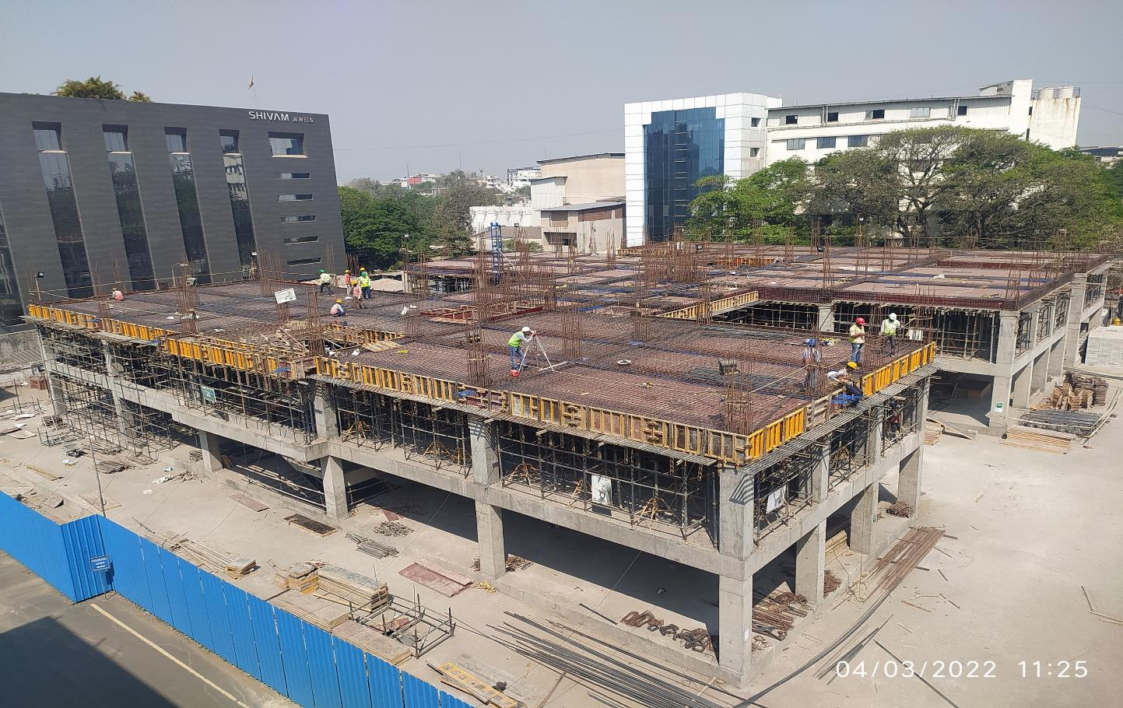
B Station
Top side view 1st Floor slab (+6.90 Lvl)

Slide 4
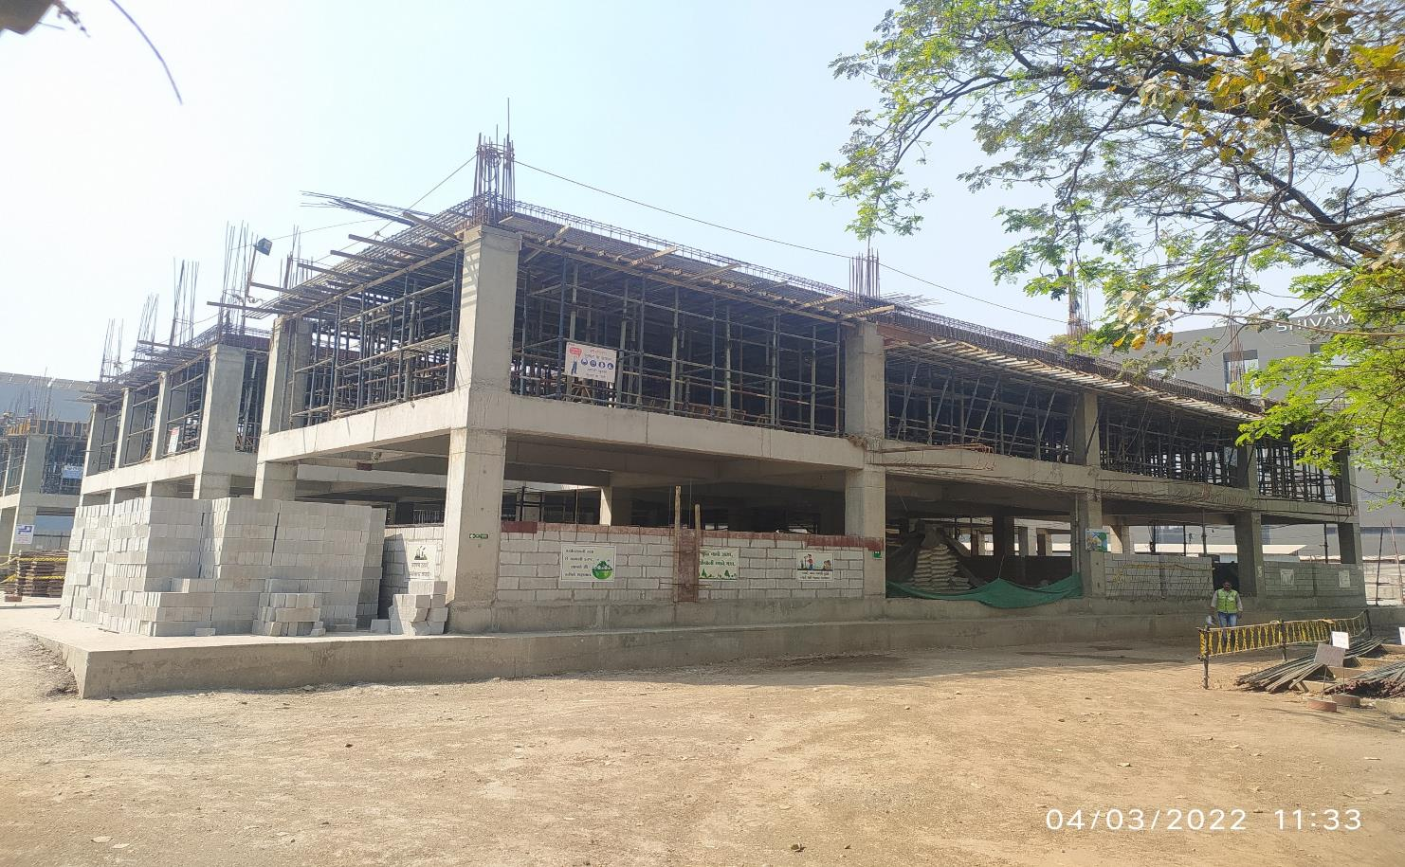
B Station
North side view

Slide 5
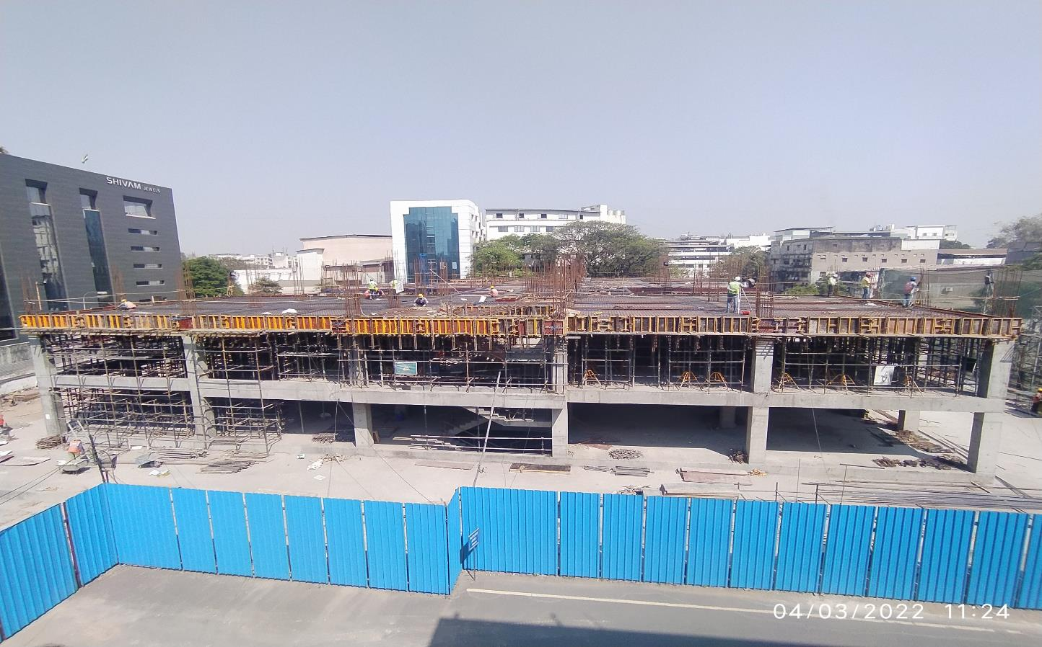
B Station
N
South side view

Slide 6
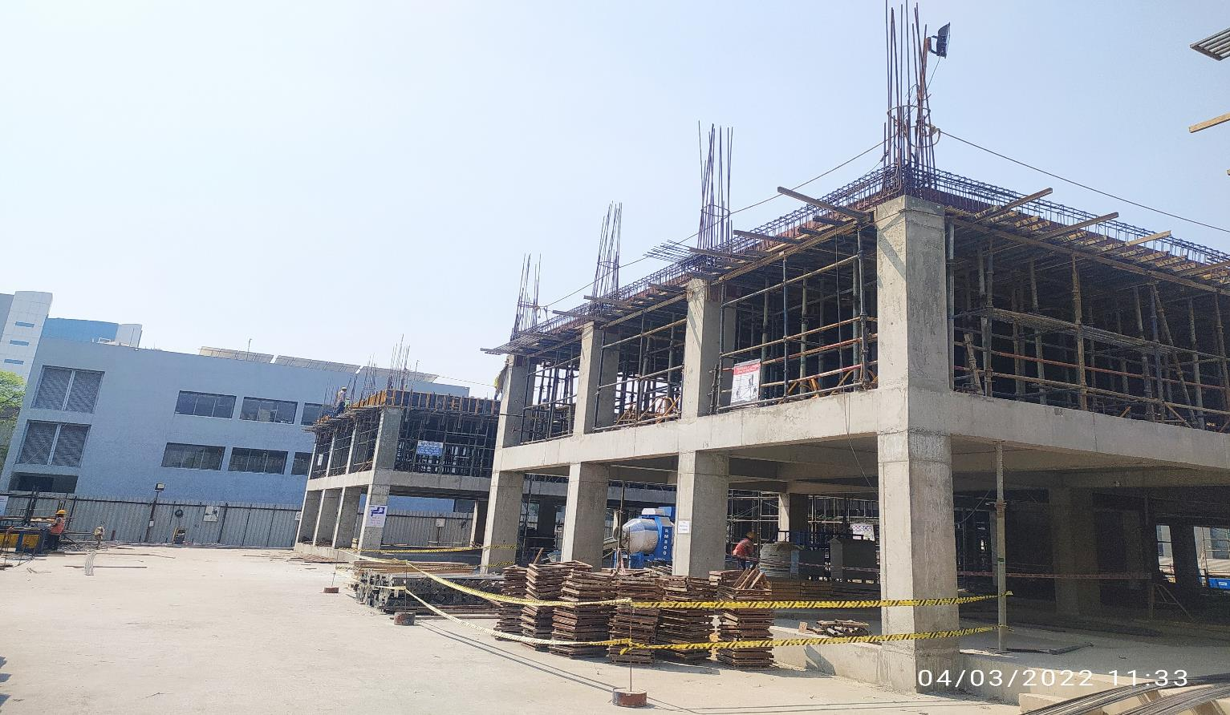
B Station
East Side View

Slide 7
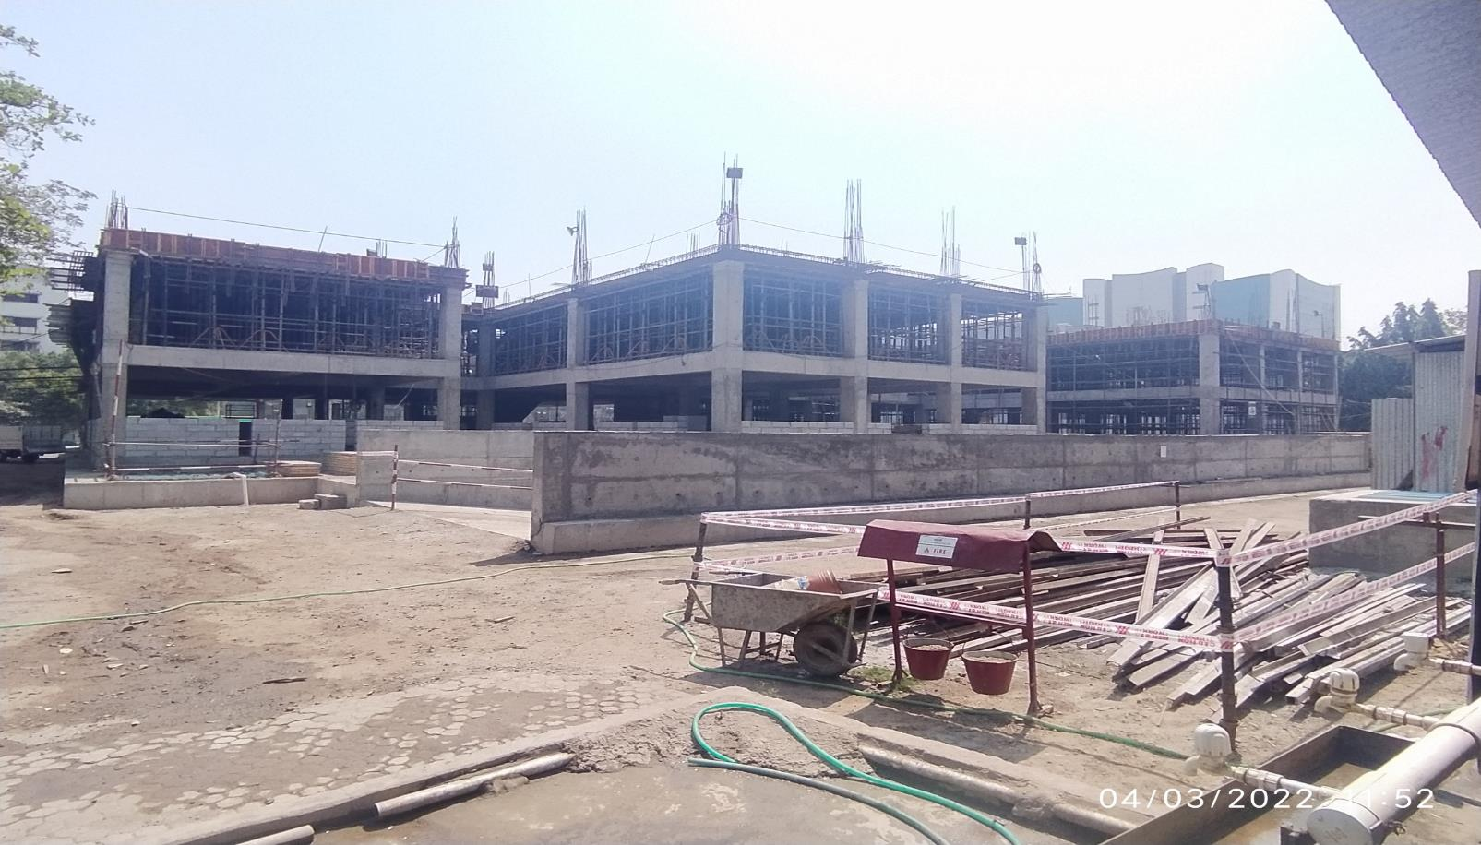
B Station
West Side View

Slide 8
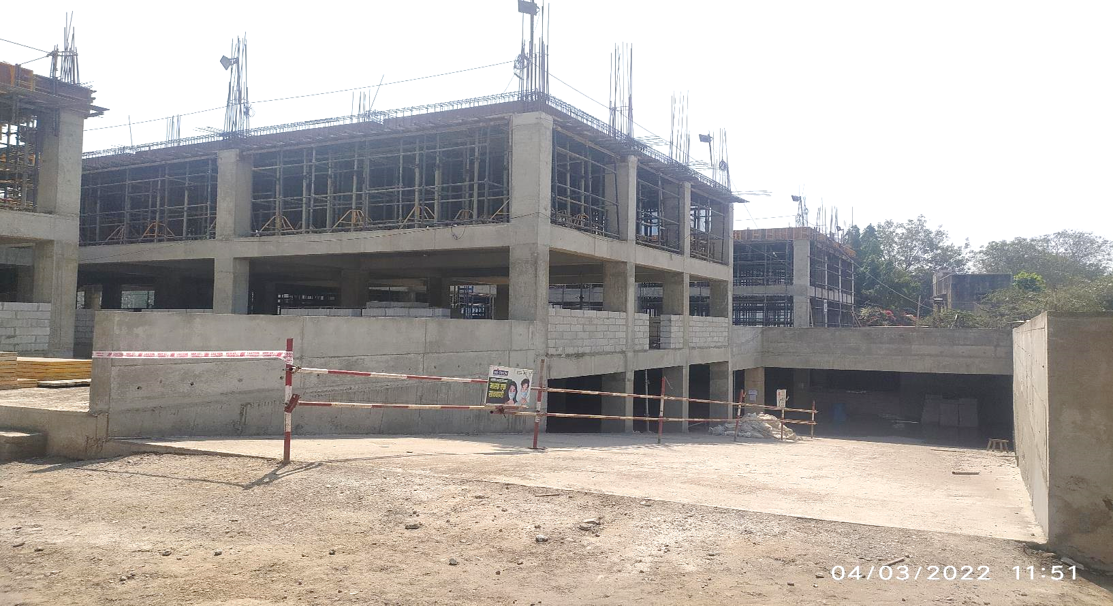
B Station
West Side Upper Basement view

Slide 9
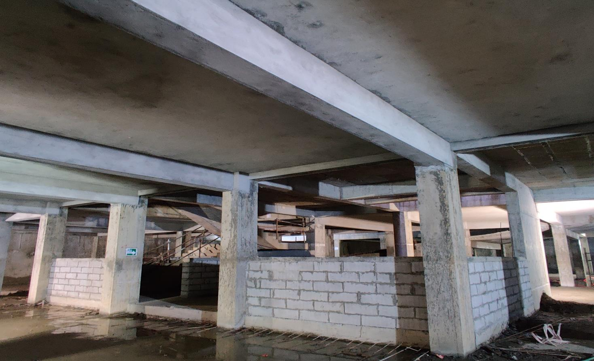
B Station
Block Work in Basement

Slide 10
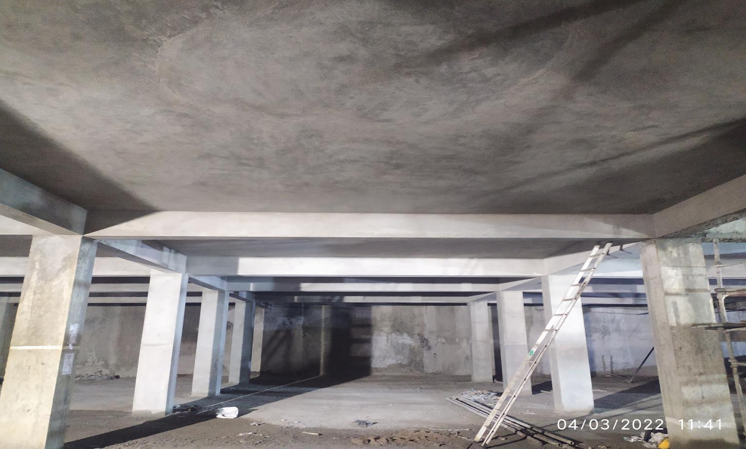
B Station
Lower Basement view – Celling Plaster Work

Slide 11
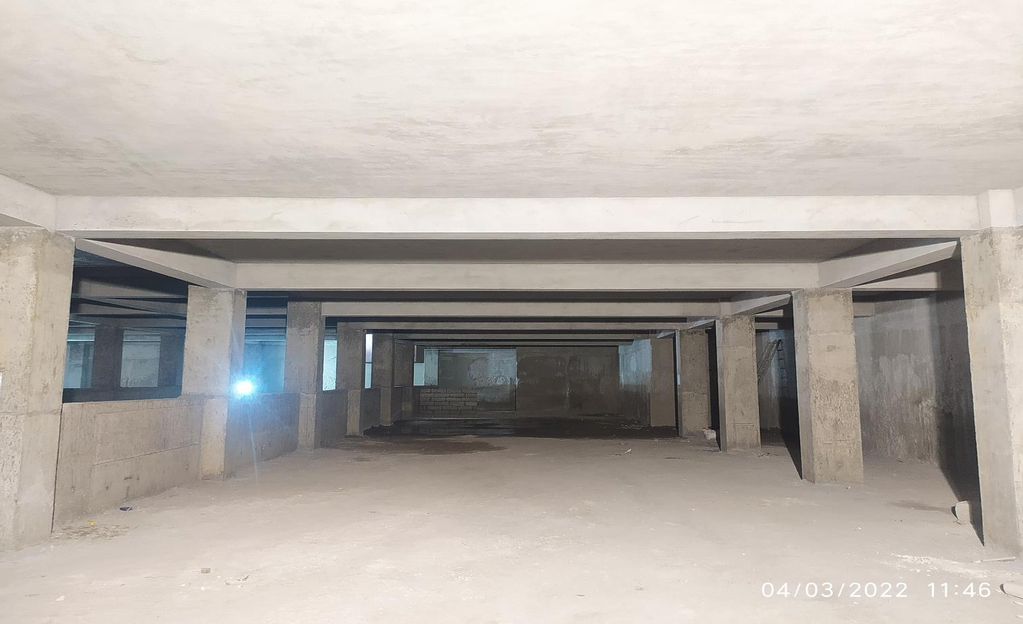
B Station
Upper Basement view – Celling Plaster Work

Slide 12
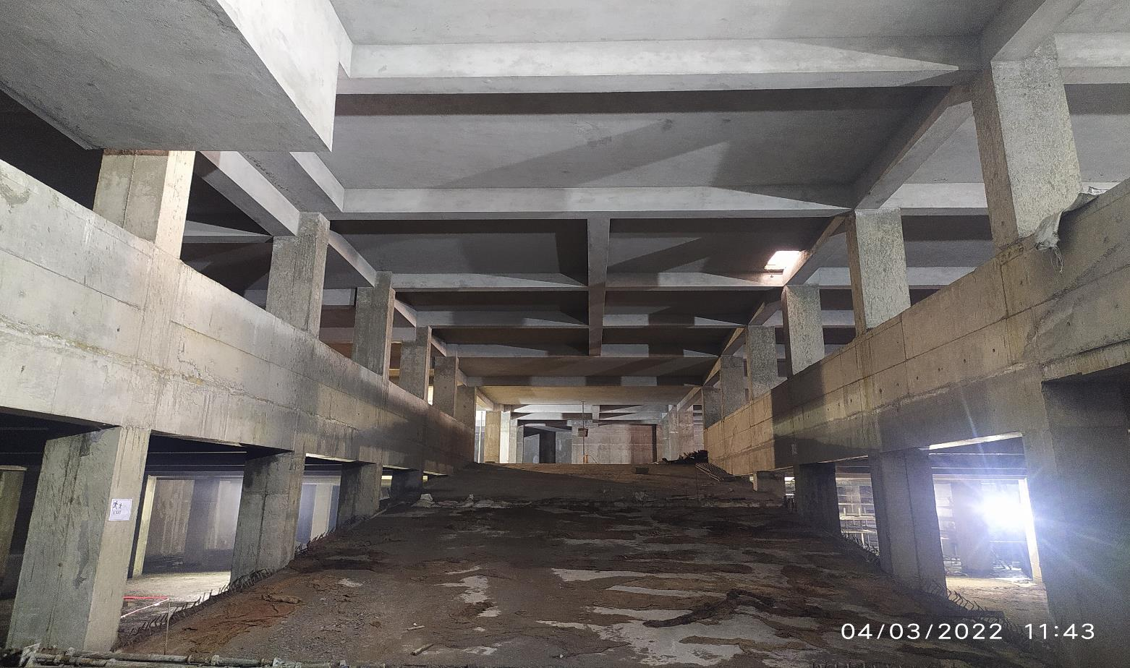
B Station
Lower Basement to Upper Basement view – Celling Plaster Work

Slide 13
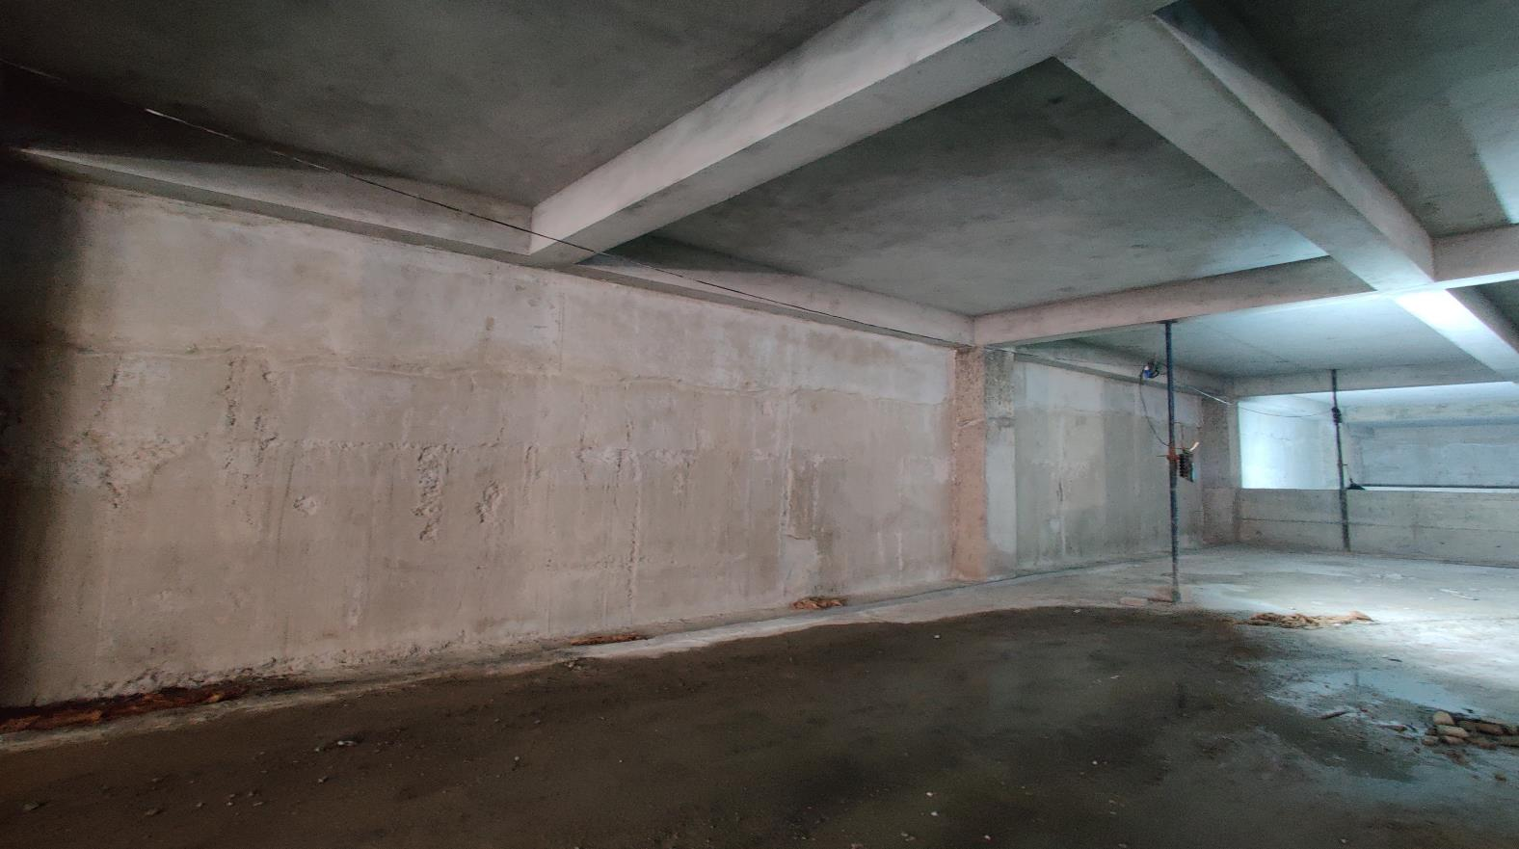
B Station
D-wall Crystalline waterproofing Work

Slide 14
Detail / Drawings Required :
Sr. No | Description | Tentative date of detail required | Remarks
1
2

Slide 15
Thank you

